Slide 1
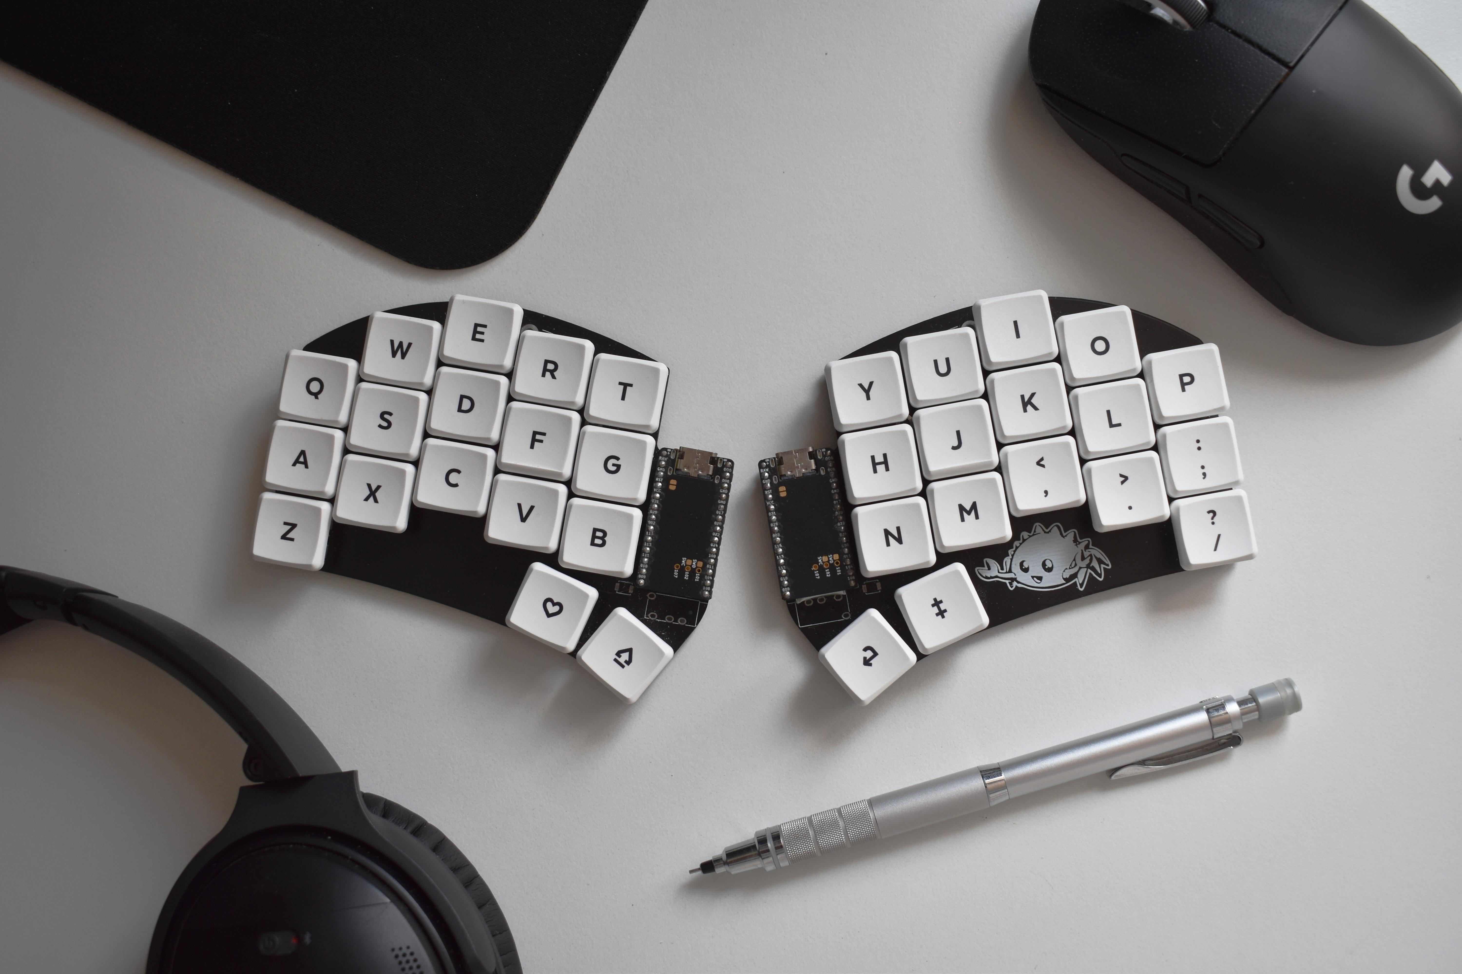

34 KEYS IS ALL YOU NEED
An ergonomic mechanical keyboard journey
Author: Mattia Dal Ben

Slide 2
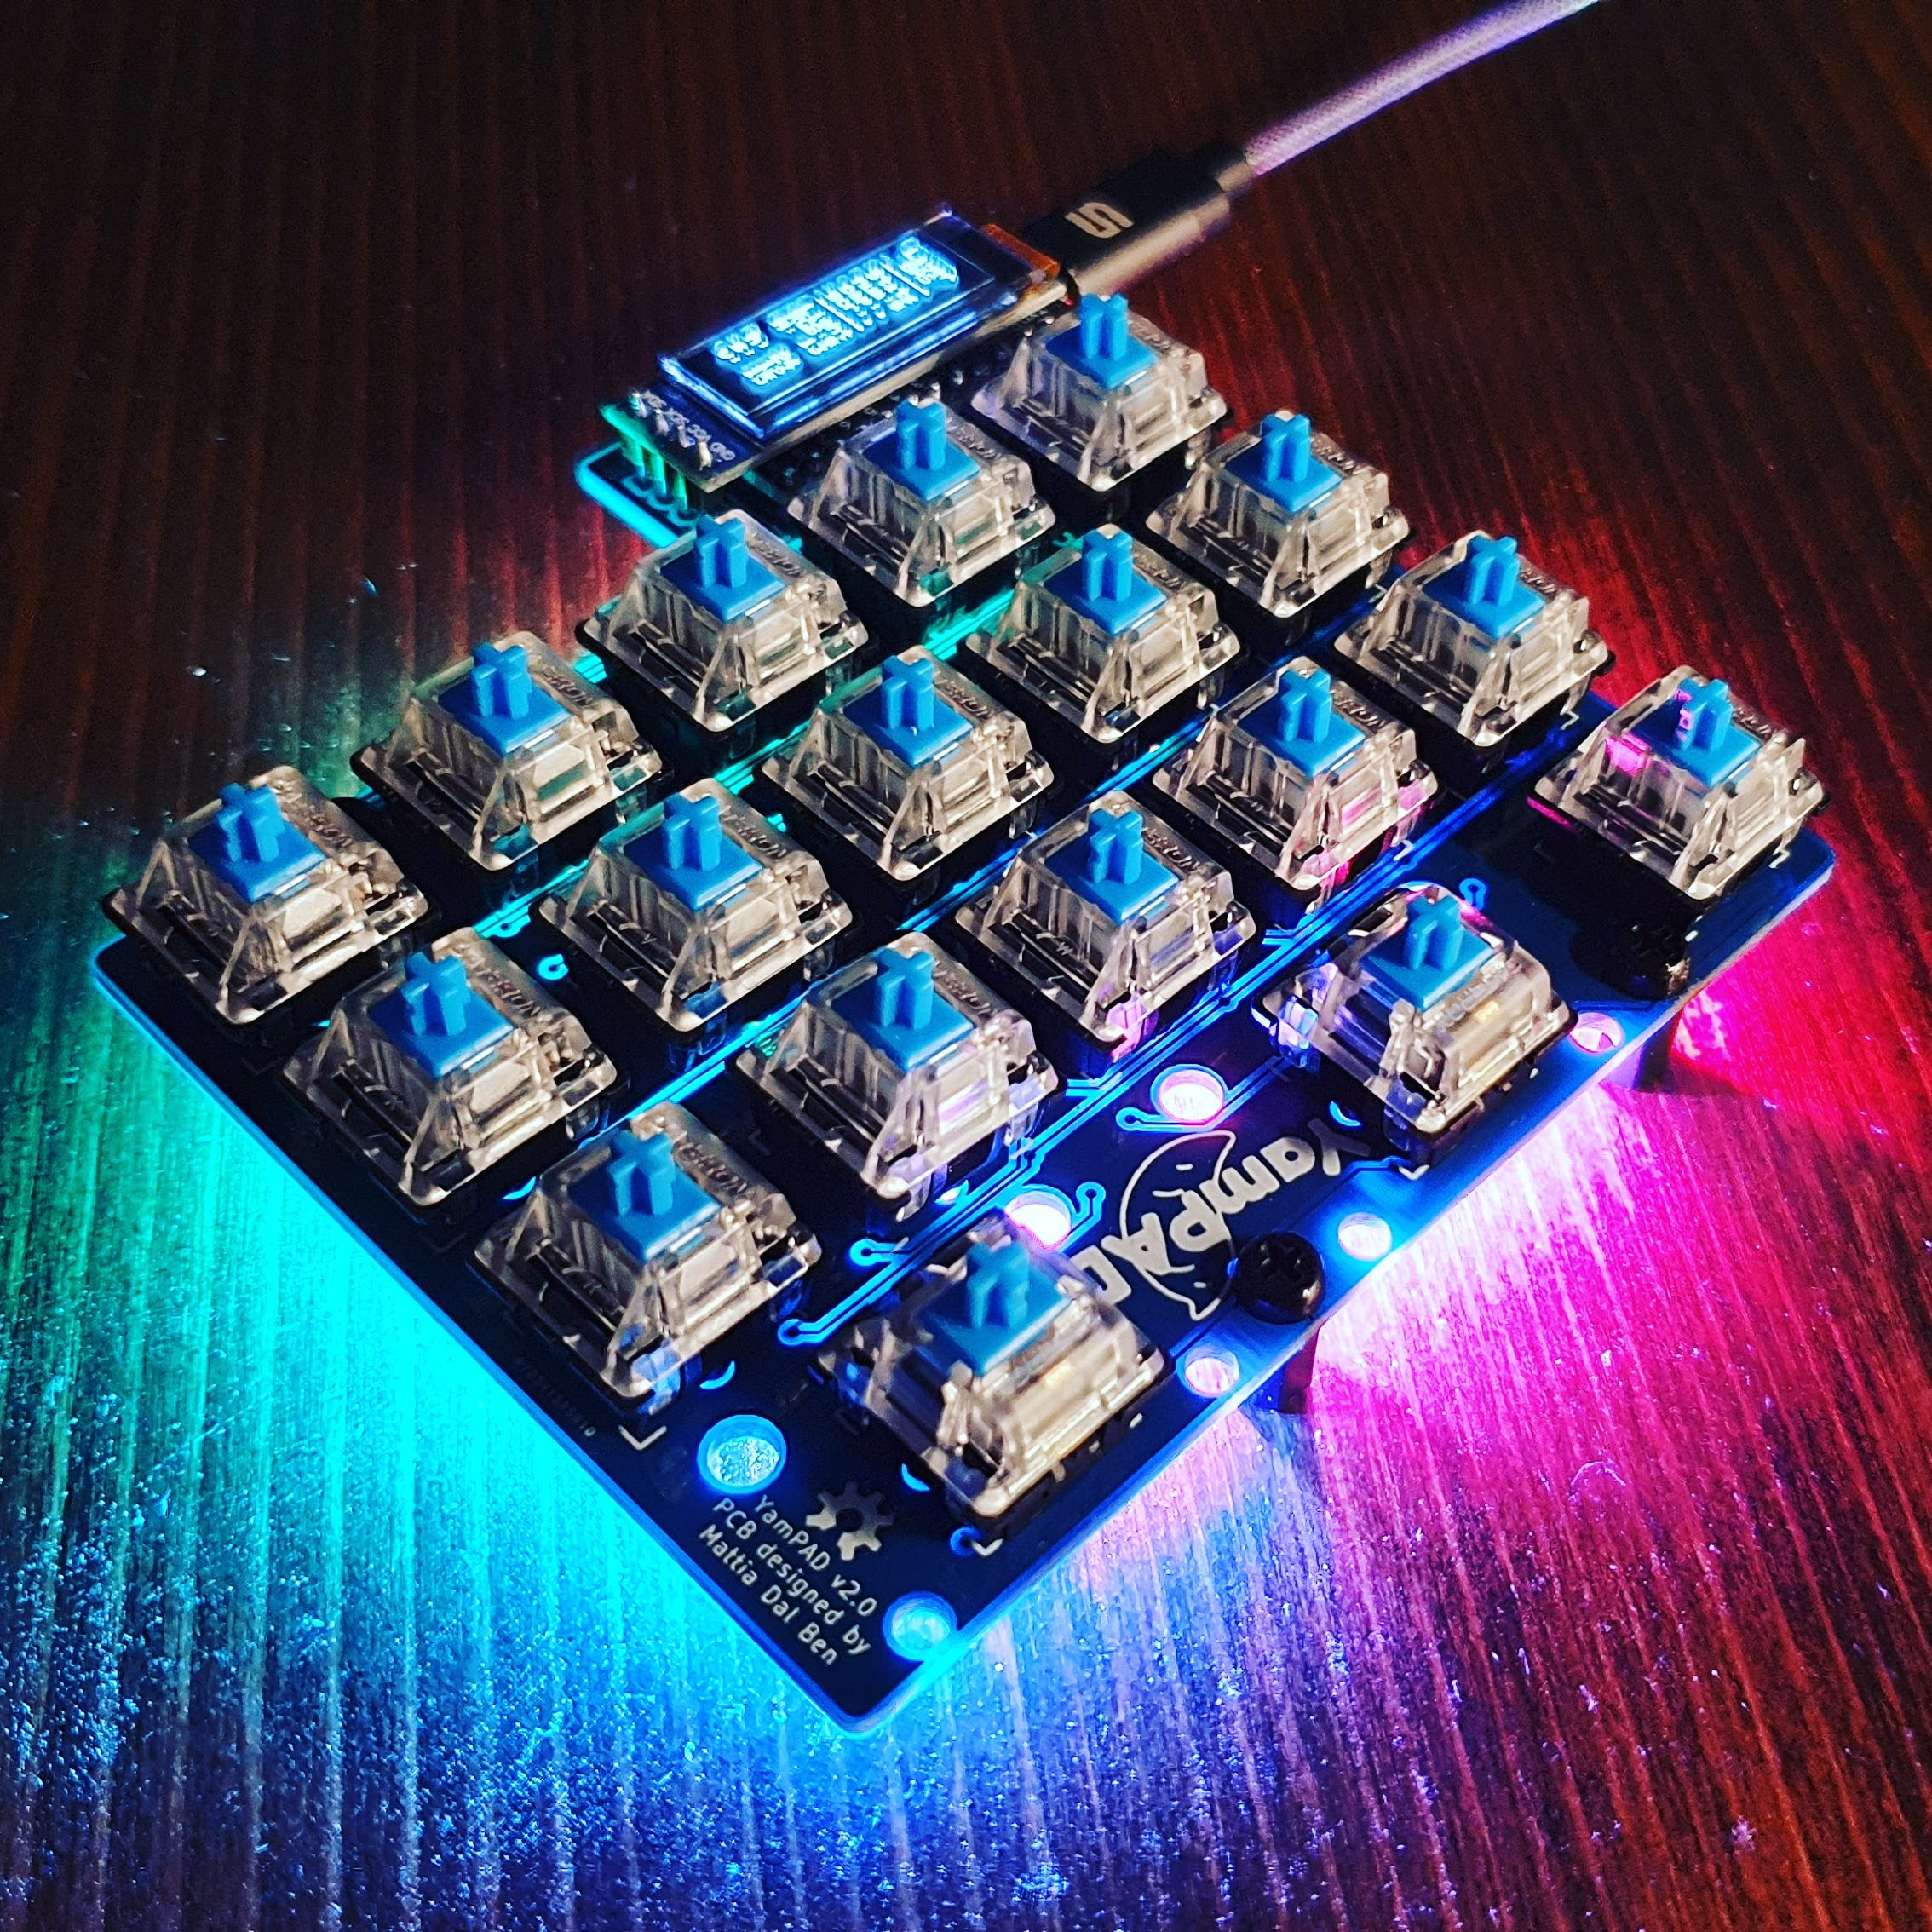
WHO AM I?
Master degree in EE
Work as SWE @ Eurotech
Mechanical keyboard enthusiast and maker
Designed the Redox Keyboard and the Yampad

Slide 3
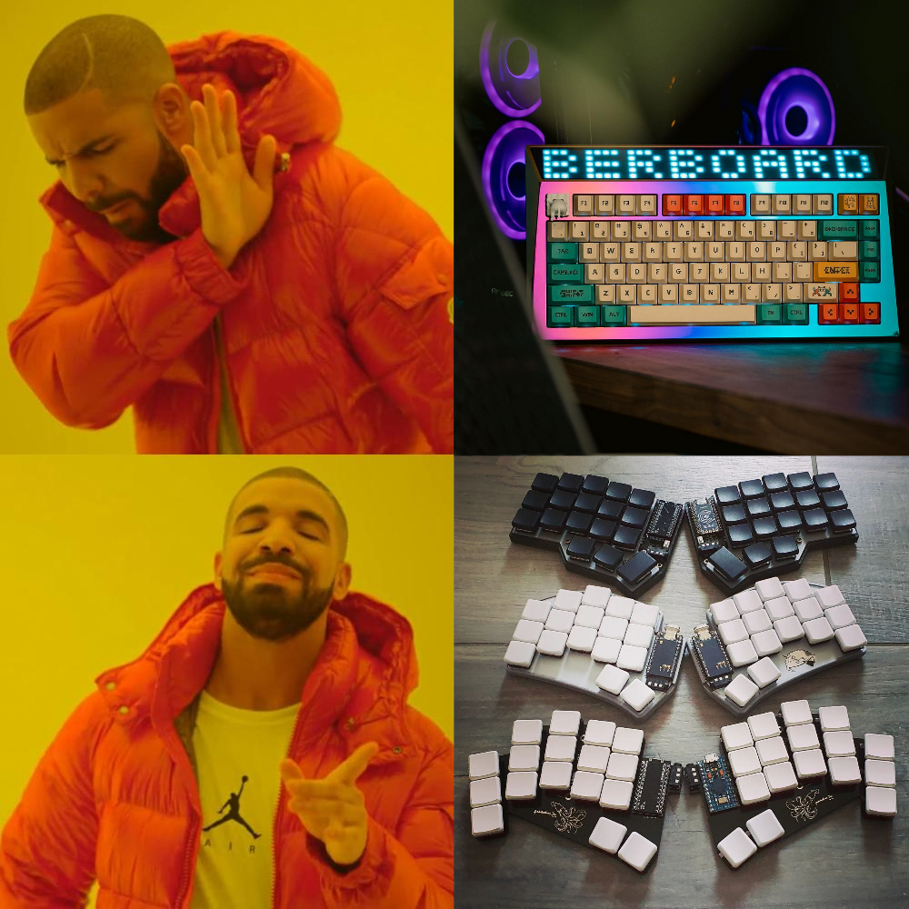
WHAT IS THIS TALK ABOUT?
Sub 40%
Ergonomic
Low profile
Open source
Mechanical
Keyboards

Slide 4
TALK OUTLINE
1
HARDWARE
2
SOFTWARE
3
LAYOUT
4
MIRYOKU

Slide 5
1.
HARDWARE

Slide 6

WHY ARE WE STILL STUCK WITH THIS?
Top: Corona Model 4 1920 ca.
Bottom: Macbook Air 2020 ca.

Slide 7
LET'S TRY AND FIX THAT

Slide 8
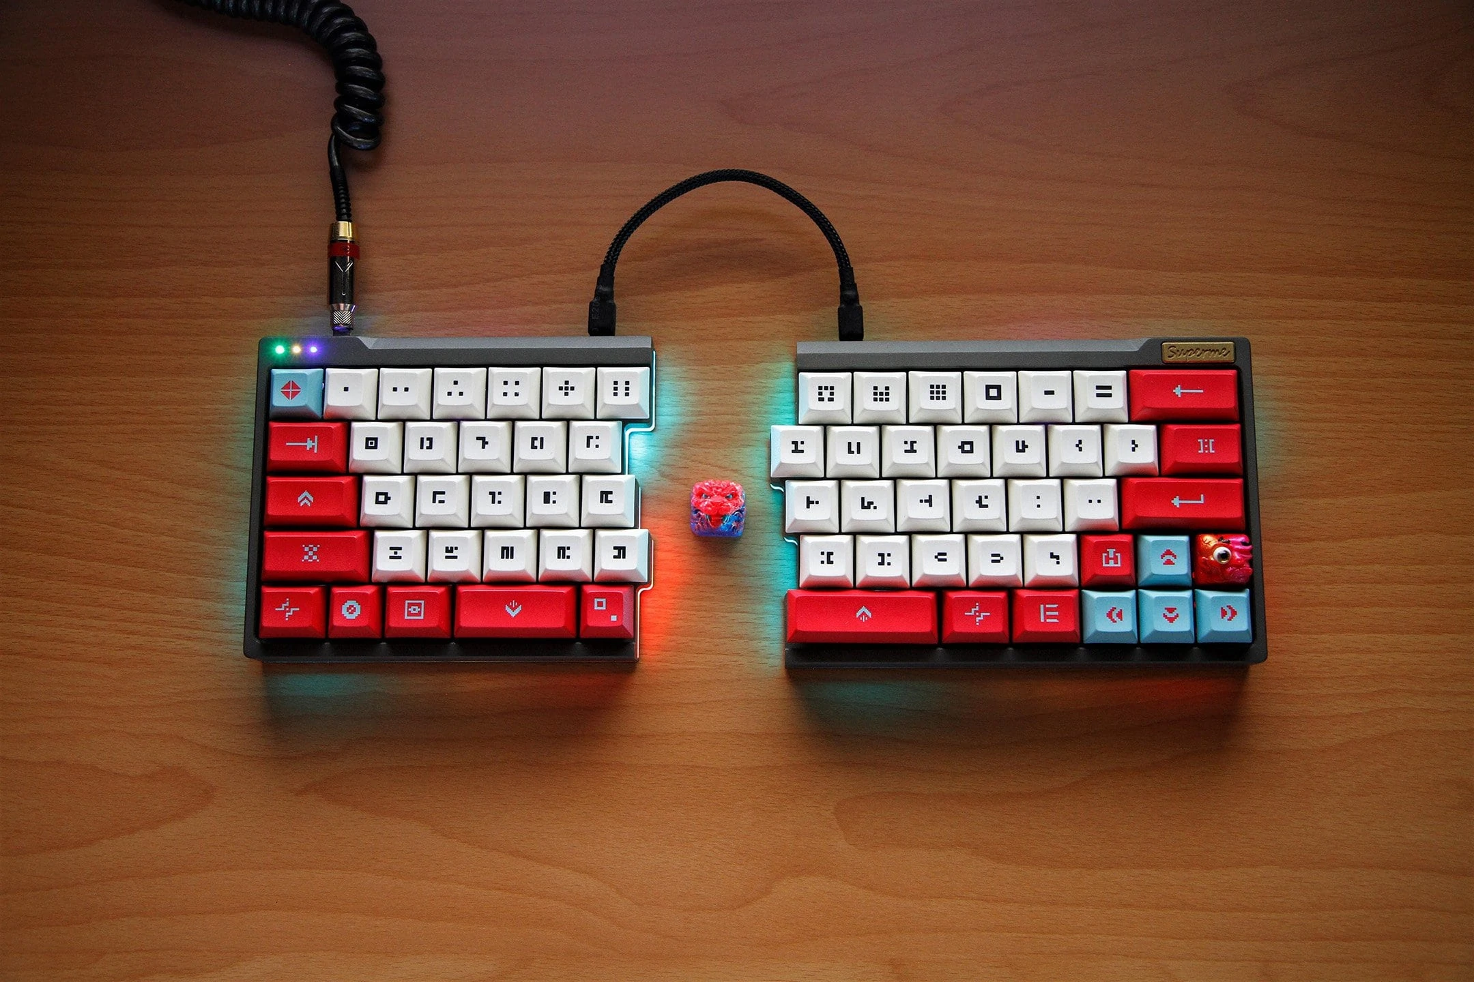
SPLIT HALVES
"Your wrist are not built to bend like that. Split the keyboard to have a more natural posture."

Slide 9
Pic: Taobao Supreme (Superme) 65% Split keyboard

Slide 10
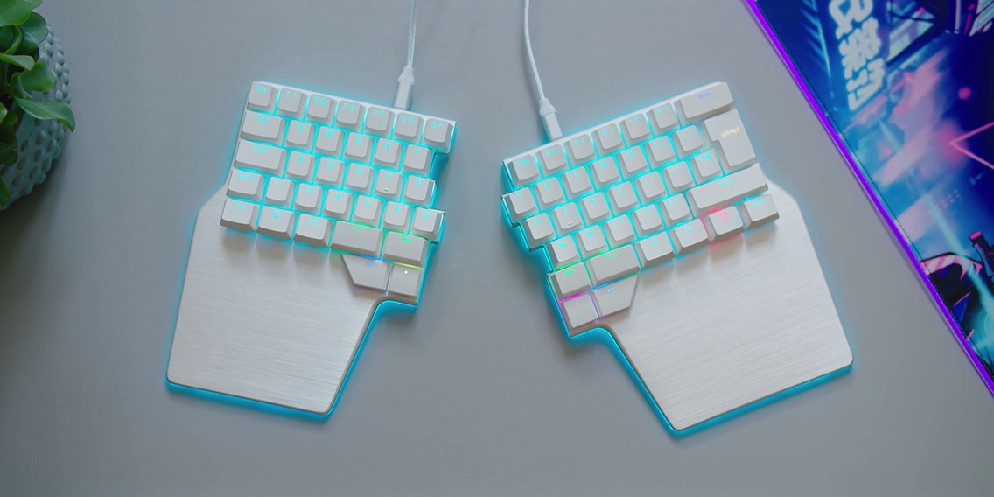
THUMB CLUSTER
"Why is your strongest finger used to press only a key?"

Slide 11
Pic: Dygma Raise

Slide 12
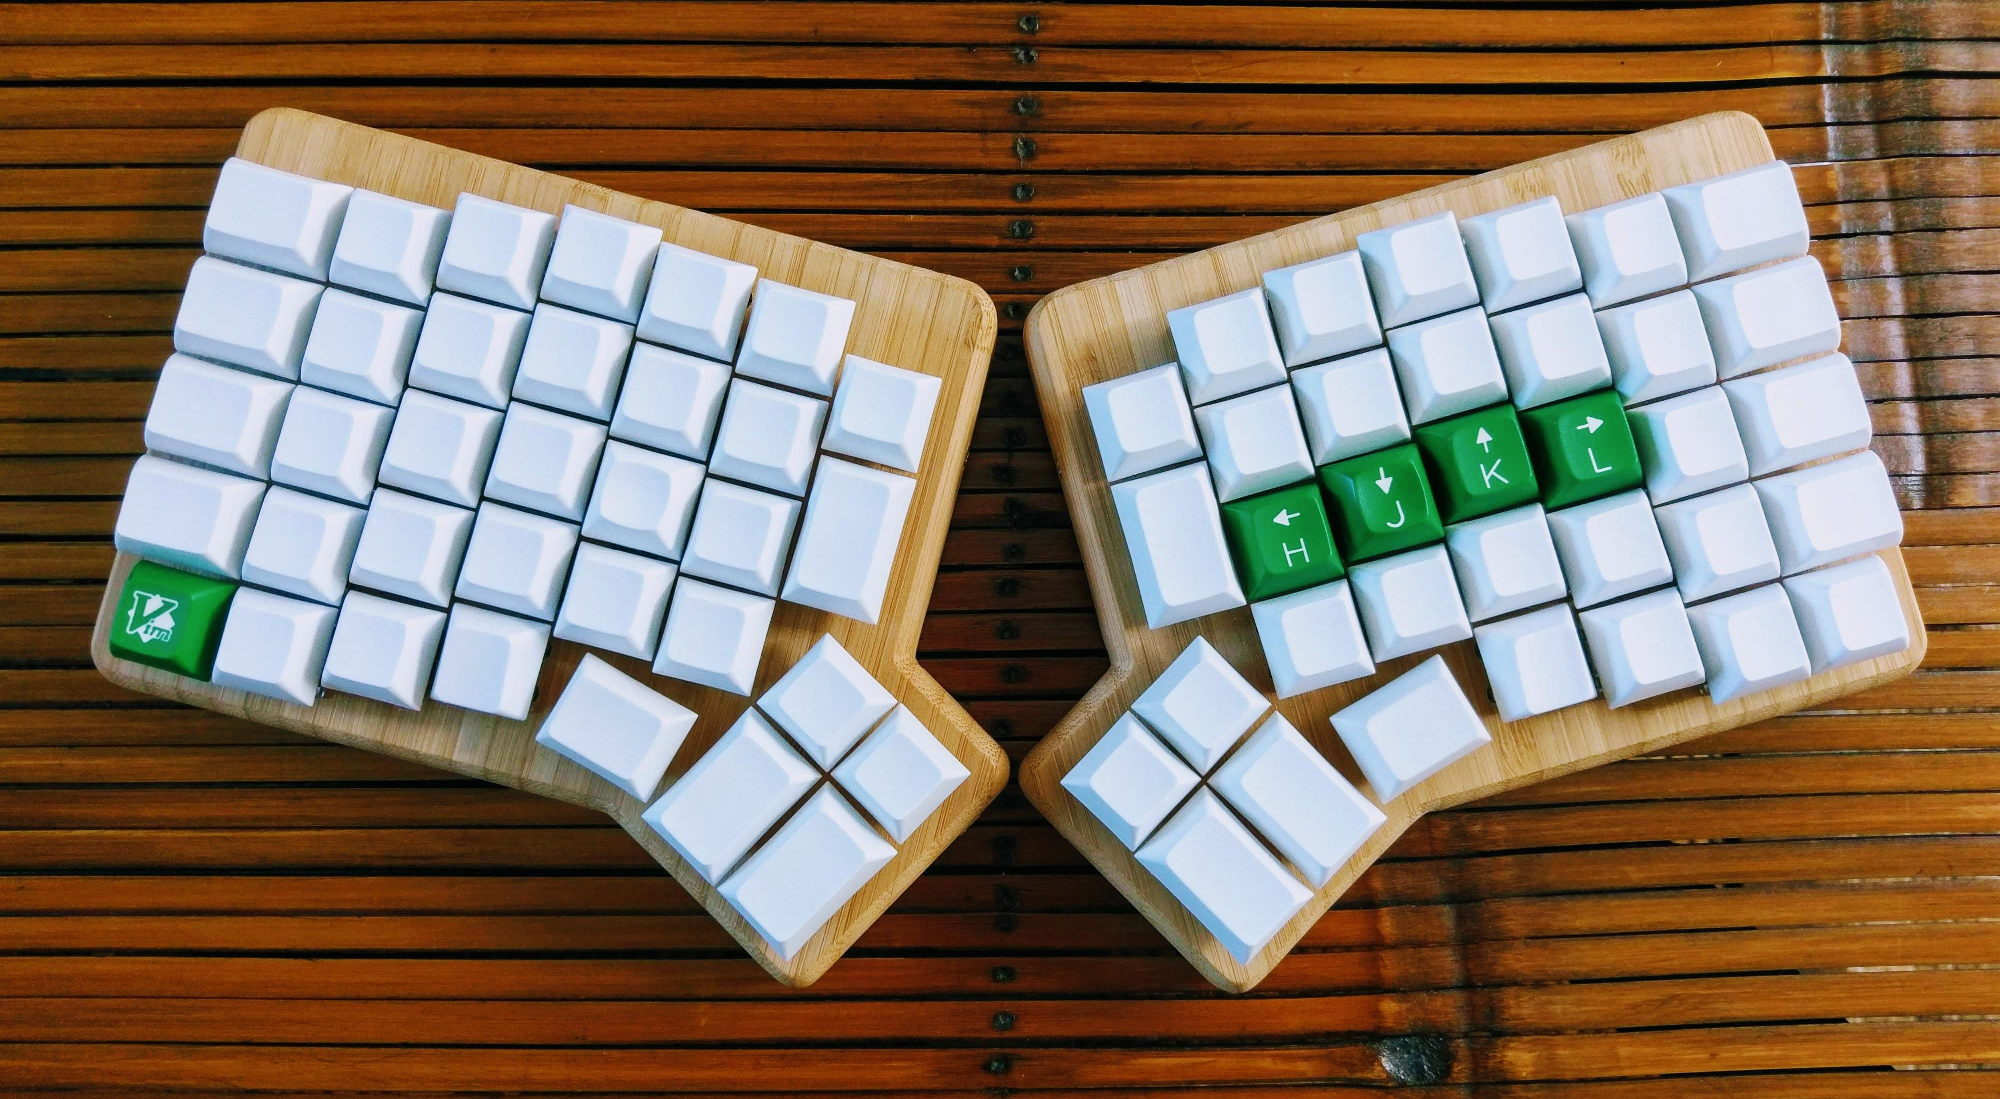
COLUMNAR STAGGER
"The row staggered layout is a heritage from the old typewriters that needed such an arrangement to prevent the percussors to get stuck."

Slide 13
Pic: Redox

Slide 14
MINIMALISM
"We are moving our keys to the fingers, we're not moving our fingers to the keys"

Slide 15
Pic: Corne

Slide 16
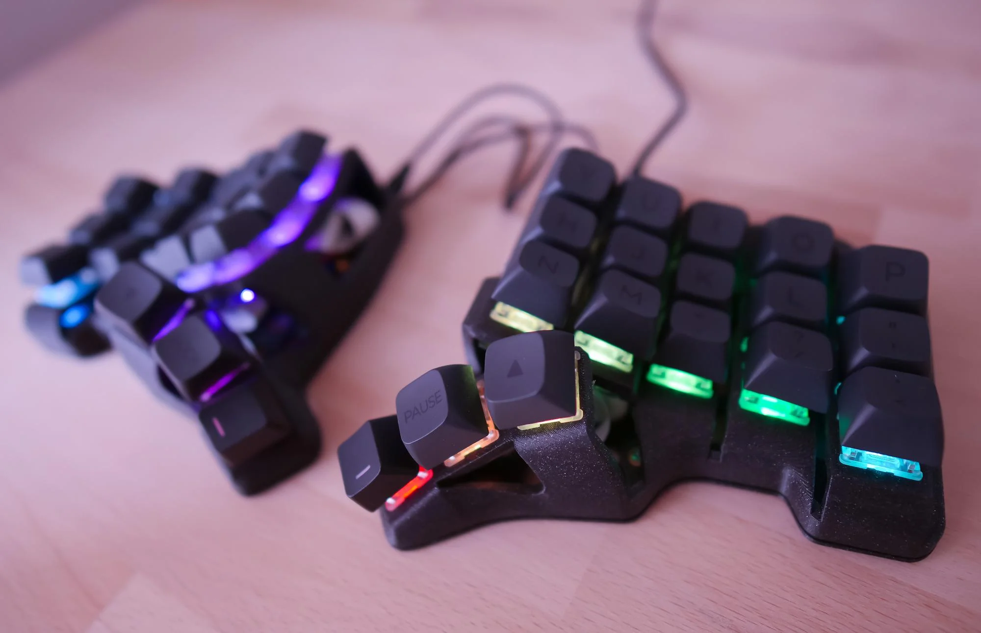
KEY WELLS AND TENTING
"A moderate elevation of the thumb side of the hand dramatically reduces the pressure on the forearm muscles."
"The concave key wells ensure the keys are reachable and mimic the curve drawn by our fingers."

Slide 17
Pic: Skeletyl

Slide 18
2.
SOFTWARE

Slide 19
KEYBOARD FIRMWARES
QMK
ZMK
(Quantum Mechanical Keyboard) Firmware is an open source (GPL-2.0) community centered around developing computer input devices. The community encompasses all sorts of input devices, such as keyboards, mice, and MIDI devices.
(Zephyr™ Mechanical Keyboard) Firmware is an open source (MIT) keyboard firmware built on the Zephyr™ Project Real Time Operating System (RTOS). ZMK's goal is to provide a modern, wireless, and powerful firmware free of licensing issues.

Slide 20
KEYBOARD FIRMWARES
FEATURES

Slide 21
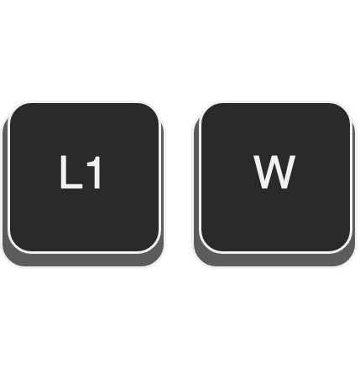
LAYERS
... this amounts to a function key that allows for different keys, much like what you would see on a laptop or tablet keyboard.
QMK: https://docs.qmk.fm/#/feature_layers
ZMK: https://zmk.dev/docs/behaviors/layers

Slide 22
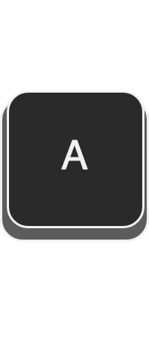
HOLD-TAP
The hold-tap key will output the 'hold' behavior if it's held for a while, and output the 'tap' behavior when it's tapped quickly.
QMK: https://docs.qmk.fm/#/tap_hold
ZMK: https://zmk.dev/docs/behaviors/hold-tap

Slide 23
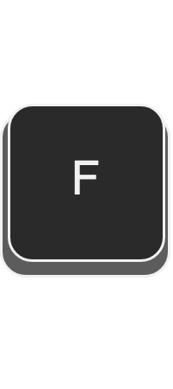
MOD-TAP
The Mod-Tap behavior either acts as a held modifier, or as a tapped keycode.
QMK: https://docs.qmk.fm/#/mod_tap
ZMK: https://zmk.dev/docs/behaviors/mod-tap

Slide 24
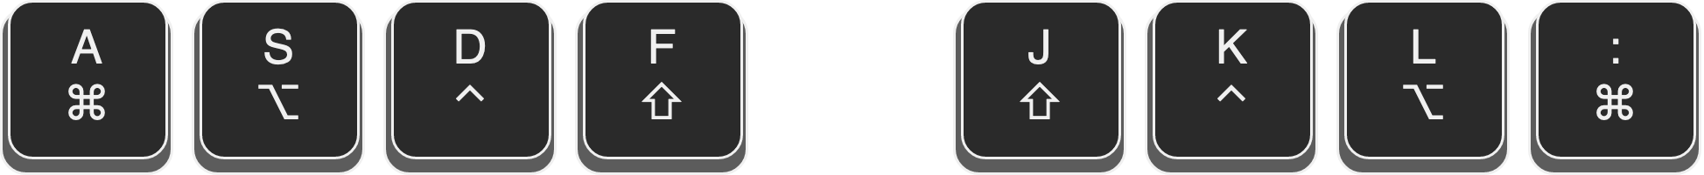
HOME ROW MODS
In simple terms, home row mods are the main modifier keys (namely Ctrl, Option/Alt, Command and Shift) on the home row of the keyboard set as Mod-taps.
Great article: https://precondition.github.io/home-row-mods

Slide 25
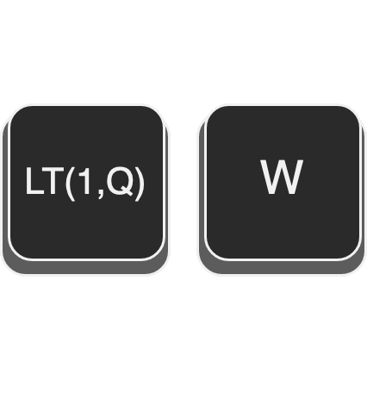
LAYER-TAP
The "layer-tap" behavior enables a layer when a key is held, and outputs a keypress when the key is only tapped for a short time.
QMK: https://docs.qmk.fm/#/feature_layers?id=switching-and-toggling-layers
ZMK: https://zmk.dev/docs/behaviors/layers#layer-tap

Slide 26
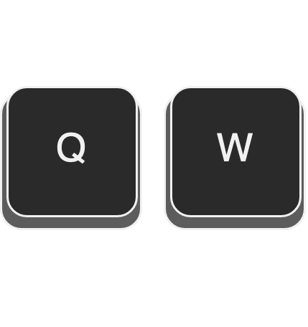
COMBOS
Combo keys are a way to combine multiple keypresses to output a different key. For example, you can hit the Q and W keys on your keyboard to output escape.
QMK: https://github.com/qmk/qmk_firmware/blob/master/docs/feature_combo.md
ZMK: https://zmk.dev/docs/features/combos

Slide 27
MORE ADVANCED FEATURES
Leader key
Conditional layers
Tap dance
Caps word
and so on...

Slide 28
3.
LAYOUT

Slide 29

WHAT'S WRONG WITH QWERTY?
"On the Prehistory of QWERTY" - Koichi Yasuoka, Motoko Yasuoka

Slide 30
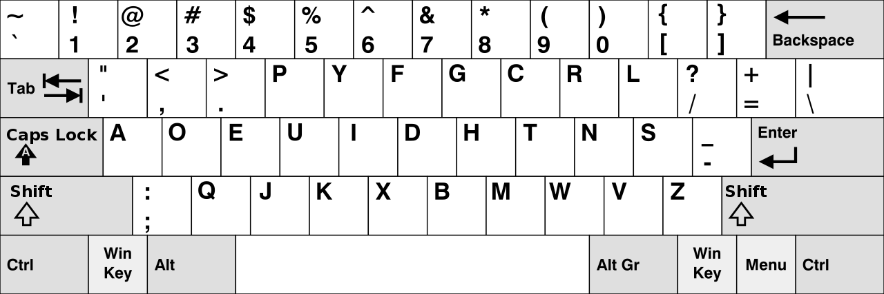
CAN WE DO BETTER?
Dvorak layout

Slide 31
CAN WE DO BETTER?
We have seen that the DVORAK layout does produce better typing speed performance than the QWERTY keyboard, but that this difference is just 4 or 5%. When we look at the history of the typewriter we can assume that people are not willing to switch to this superior design: the gain is too small compared to the costs of retraining.
The major feature of Dvorak's DSK, however, is its optimised key placement. The DSK is designed for touch typing and significantly reduces finger movement and thus typists' fatigue. Though this ergonomic feature has been pointed out in many different studies – and in fact is quite evident – this has not convinced the general public that they are better off with the DVORAK layout.
"Comparing Different Keyboard Layouts: Aspects of QWERTY, DVORAK and alphabetical keyboards"

Slide 32
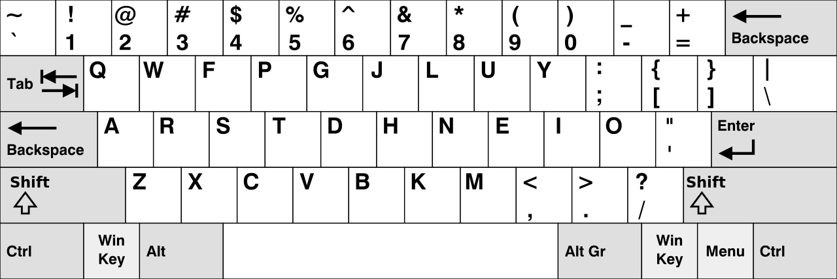
COLEMAK LAYOUT
Coleman states that he designed Colemak to be easy to learn, explaining that Dvorak is hard for QWERTY typists to learn due to it being so different from the QWERTY layout.

Slide 33
4.
MIRYOKU

Slide 34
LET'S PUT IT ALL TOGETHER NOW

Slide 35
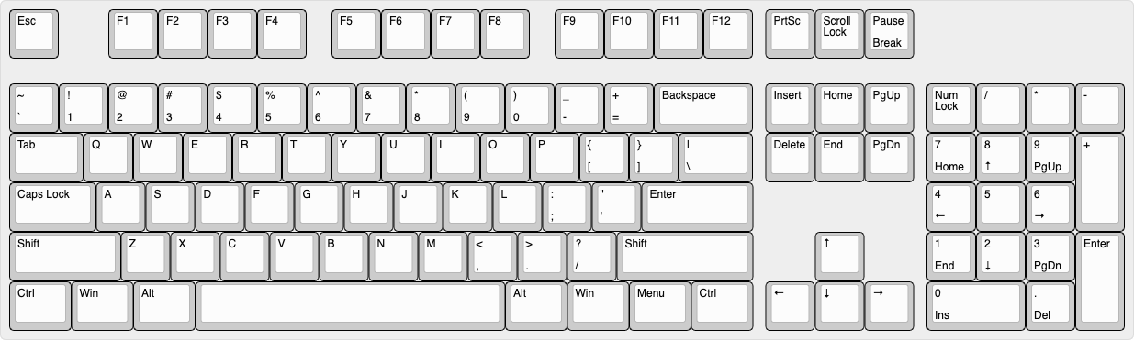
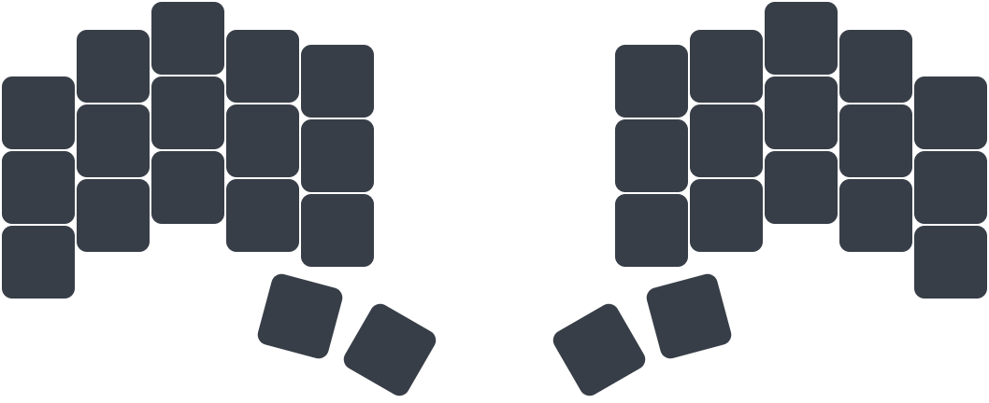
BASE LAYER

Slide 36
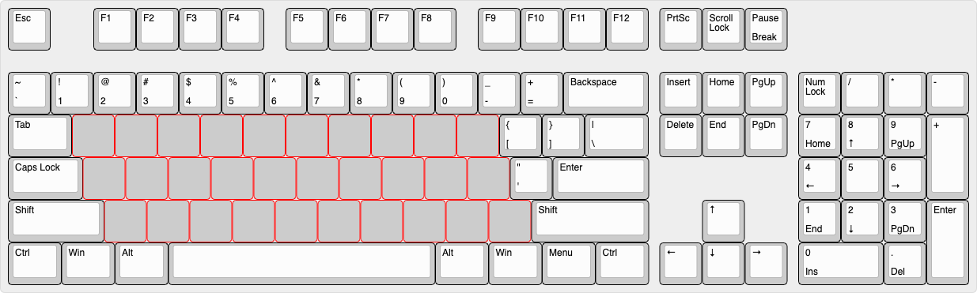
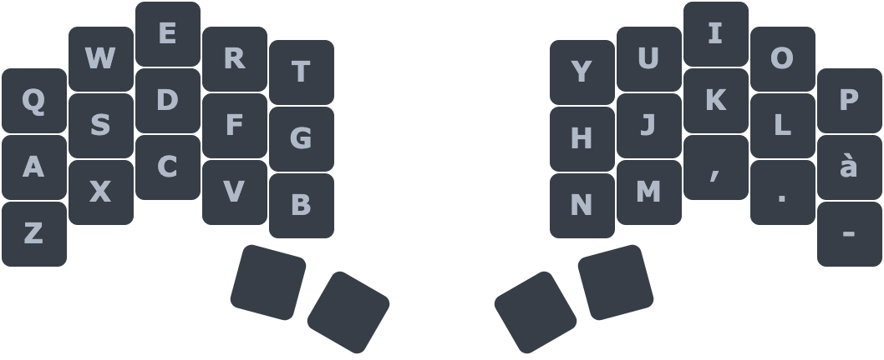
BASE LAYER

Slide 37
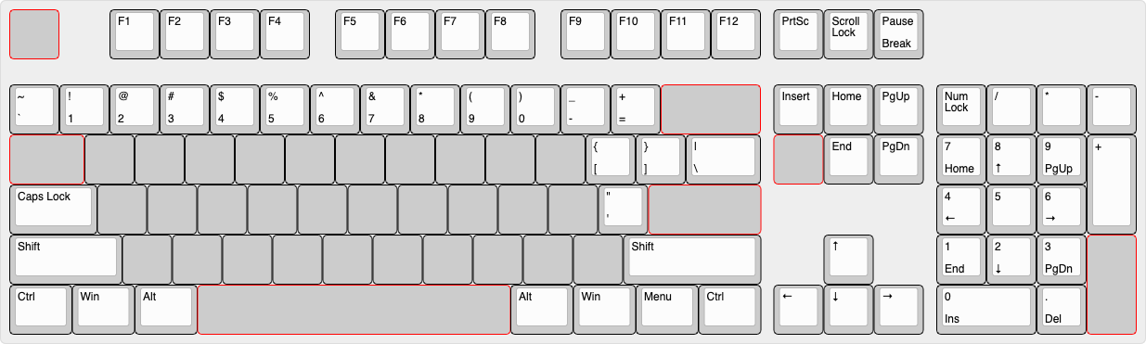
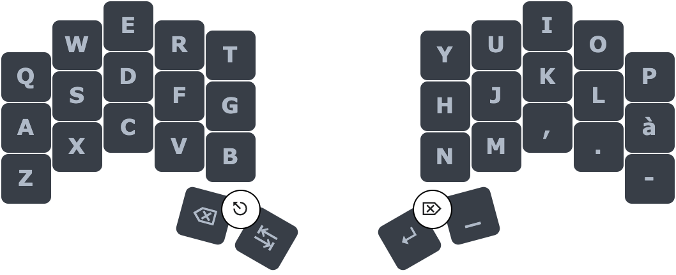
BASE LAYER

Slide 38
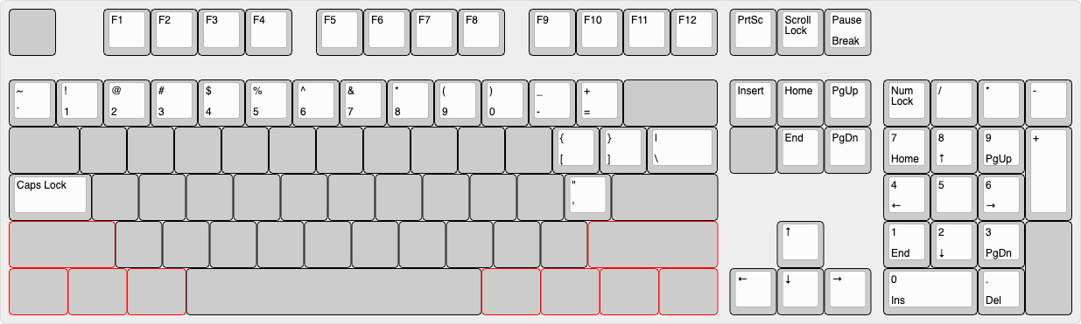
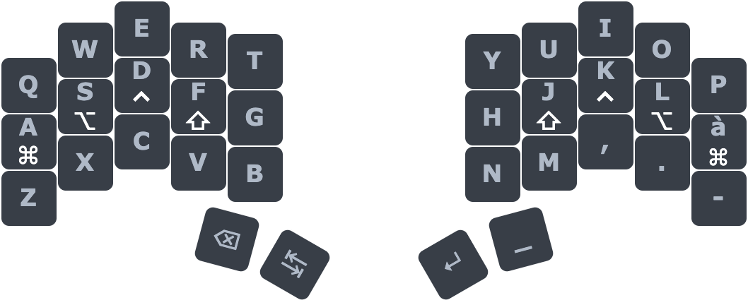
BASE LAYER

Slide 39
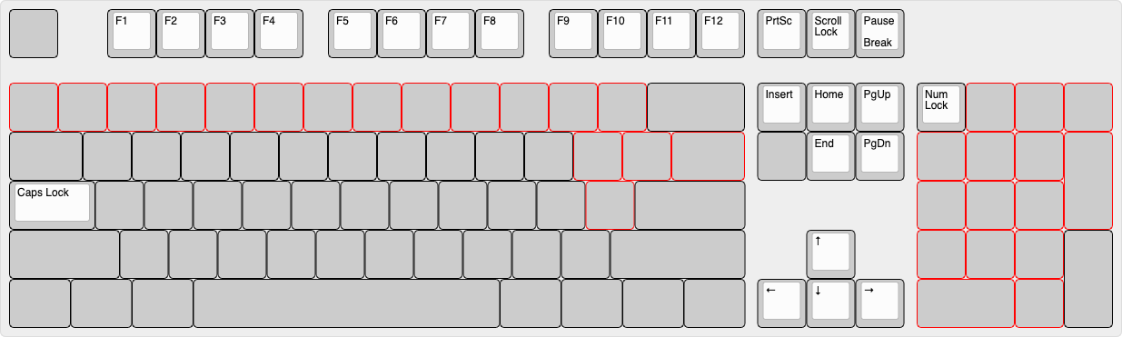
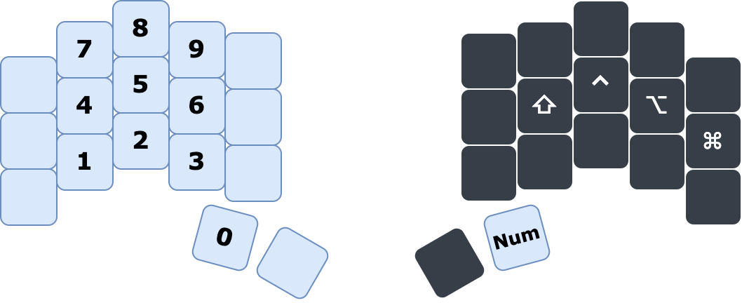
NUM LAYER

Slide 40
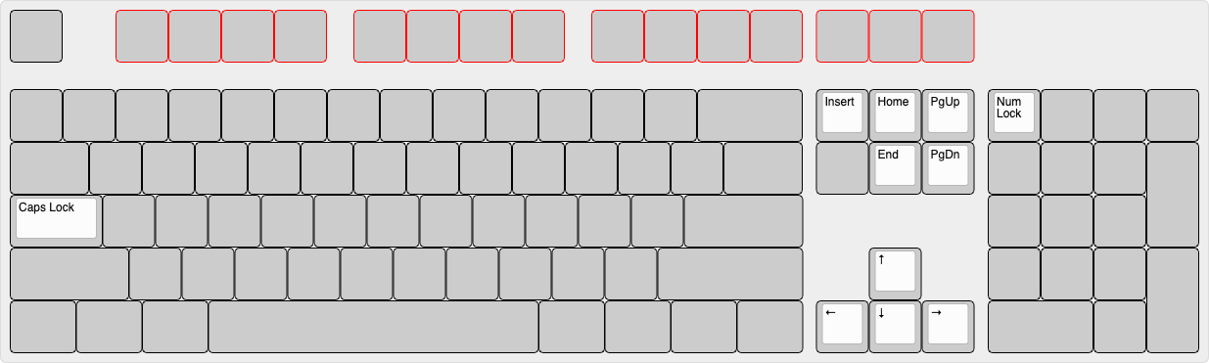
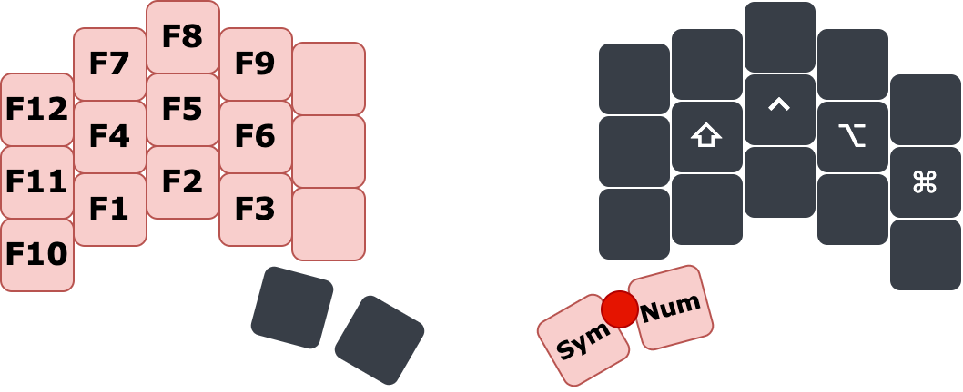
FUN LAYER

Slide 41
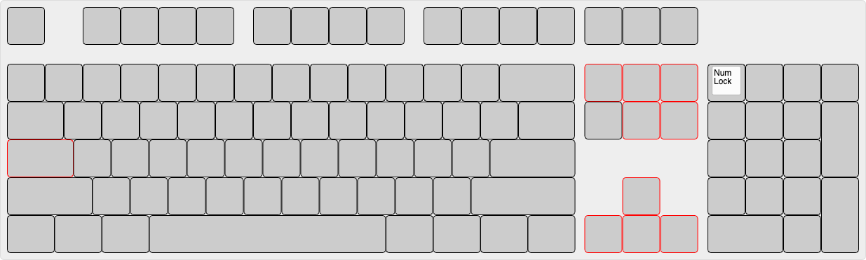
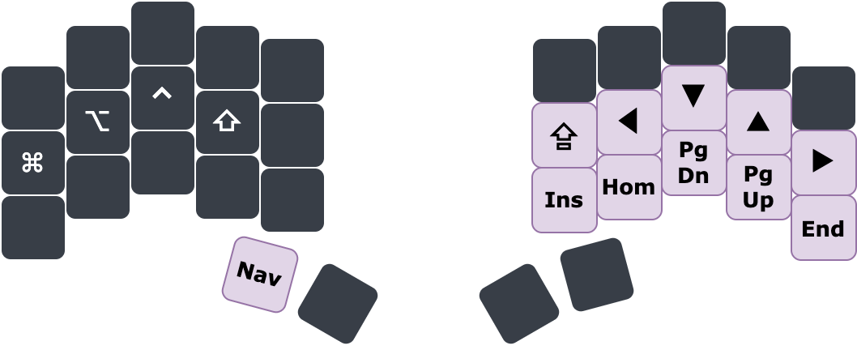
NAV LAYER

Slide 42
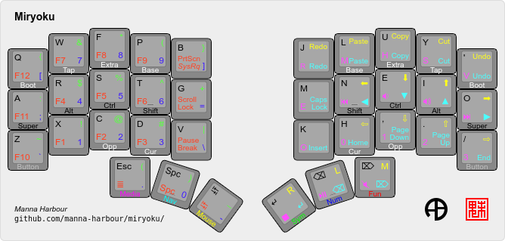
THE MIRYOKU LAYOUT
Docs: https://github.com/manna-harbour/miryoku

Slide 43
5.
CONCLUSIONS

Slide 44
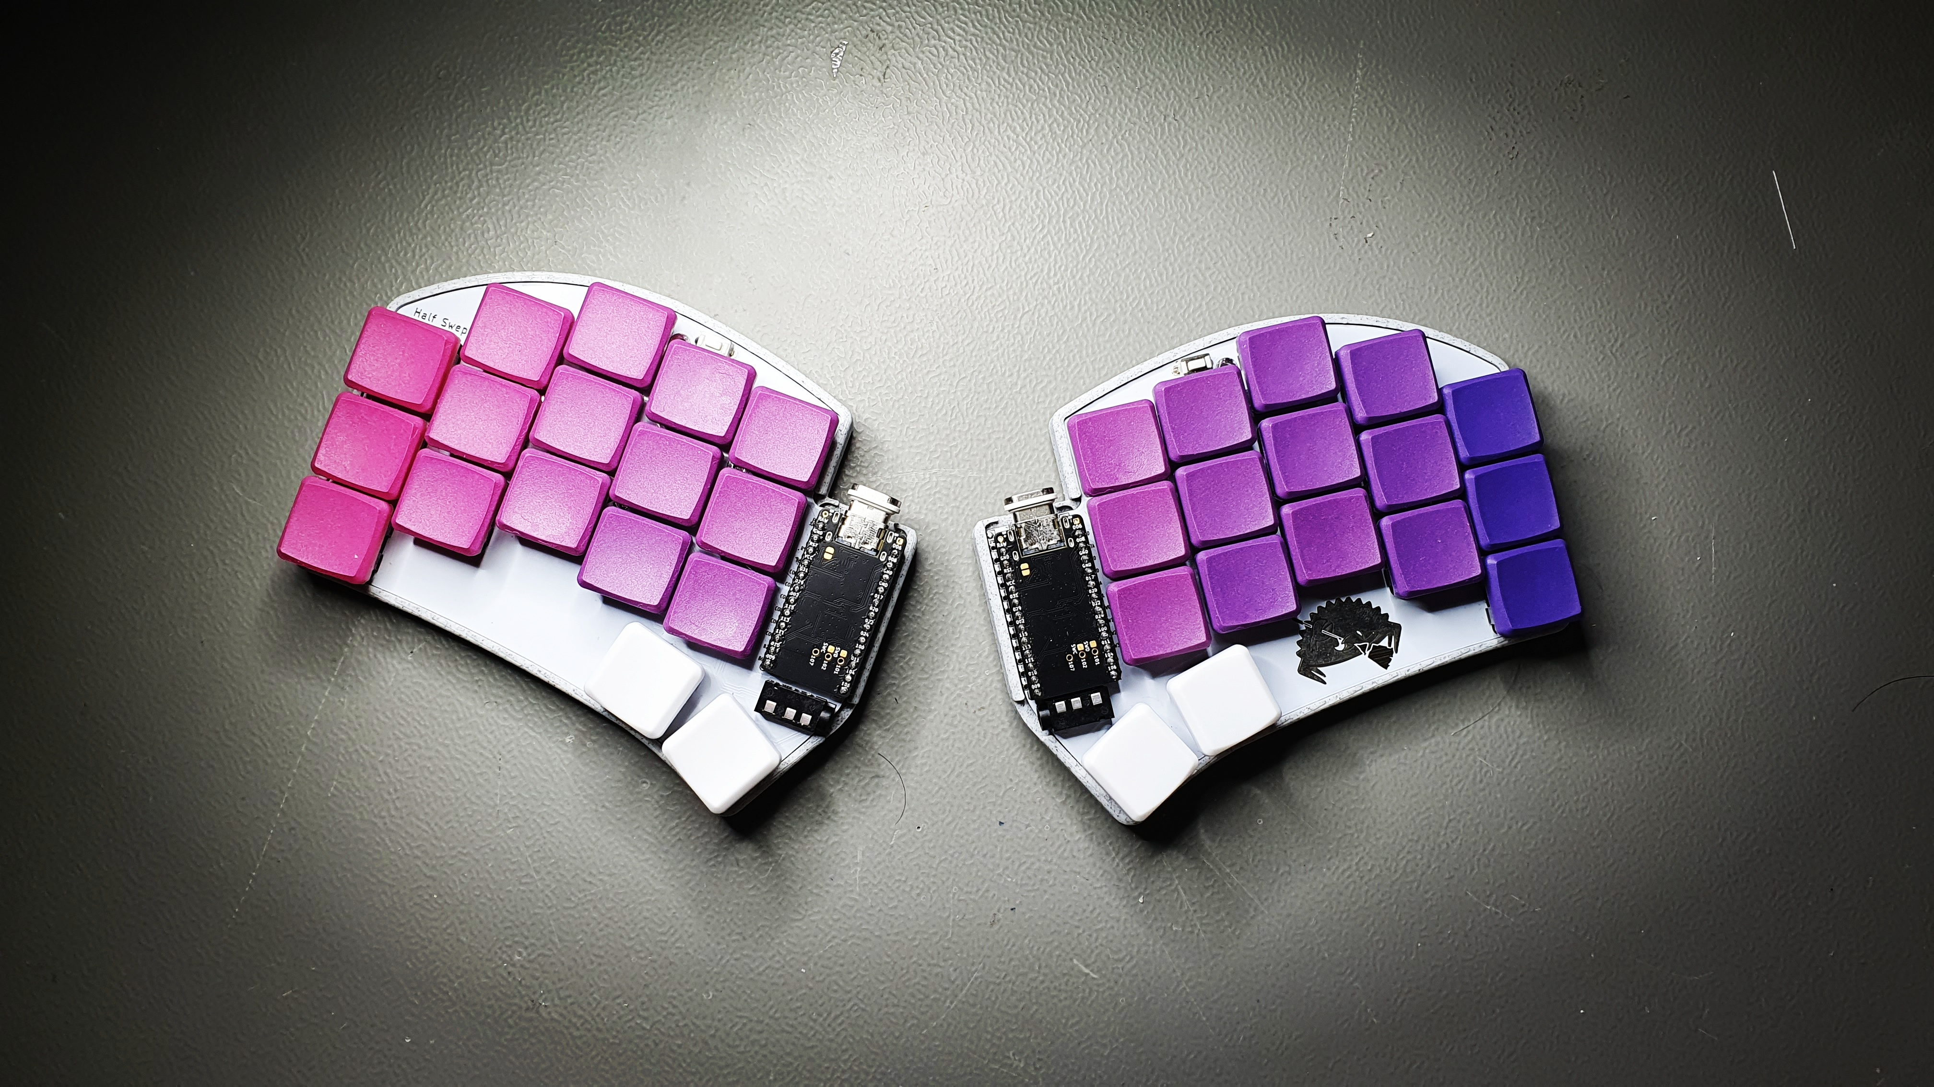
Pic: Ferris Sweep Half Swept in custom 3D printed case w/ Nice!NanosV2 running ZMK

Slide 45
PERSONAL EXPERIENCE
It improved my typing habits
The "limitations" of this keyboard made me discover new improved typing habits
Shortcuts are so much more comfortable to type
Improved symbols access
I've yet to encounter a key combination that I cannot type
It is FUN

Slide 46
TALK TAKEAWAYS
Minimal (sub 40 keys) ergonomic keyboards are viable, if not preferable to normal keyboards.
The techniques developed for this keyboard to work might come useful for all keyboard users.
Give them a try!

Slide 47
CAN WE GO DEEPER?

Slide 48
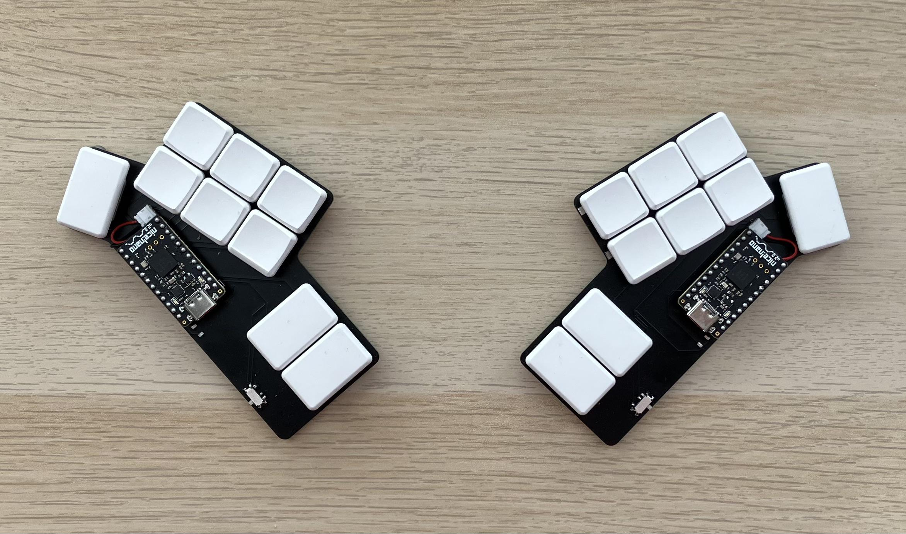
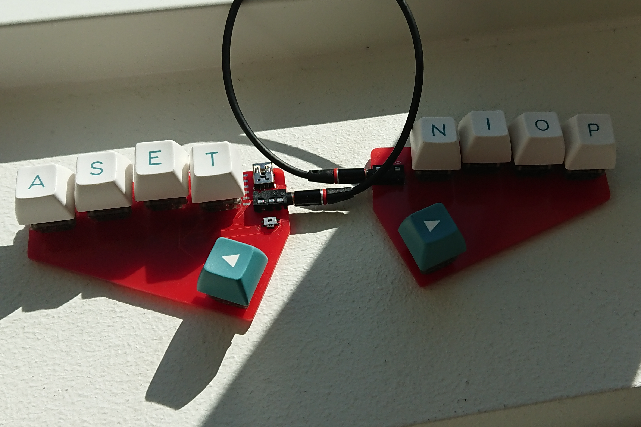

Slide 49
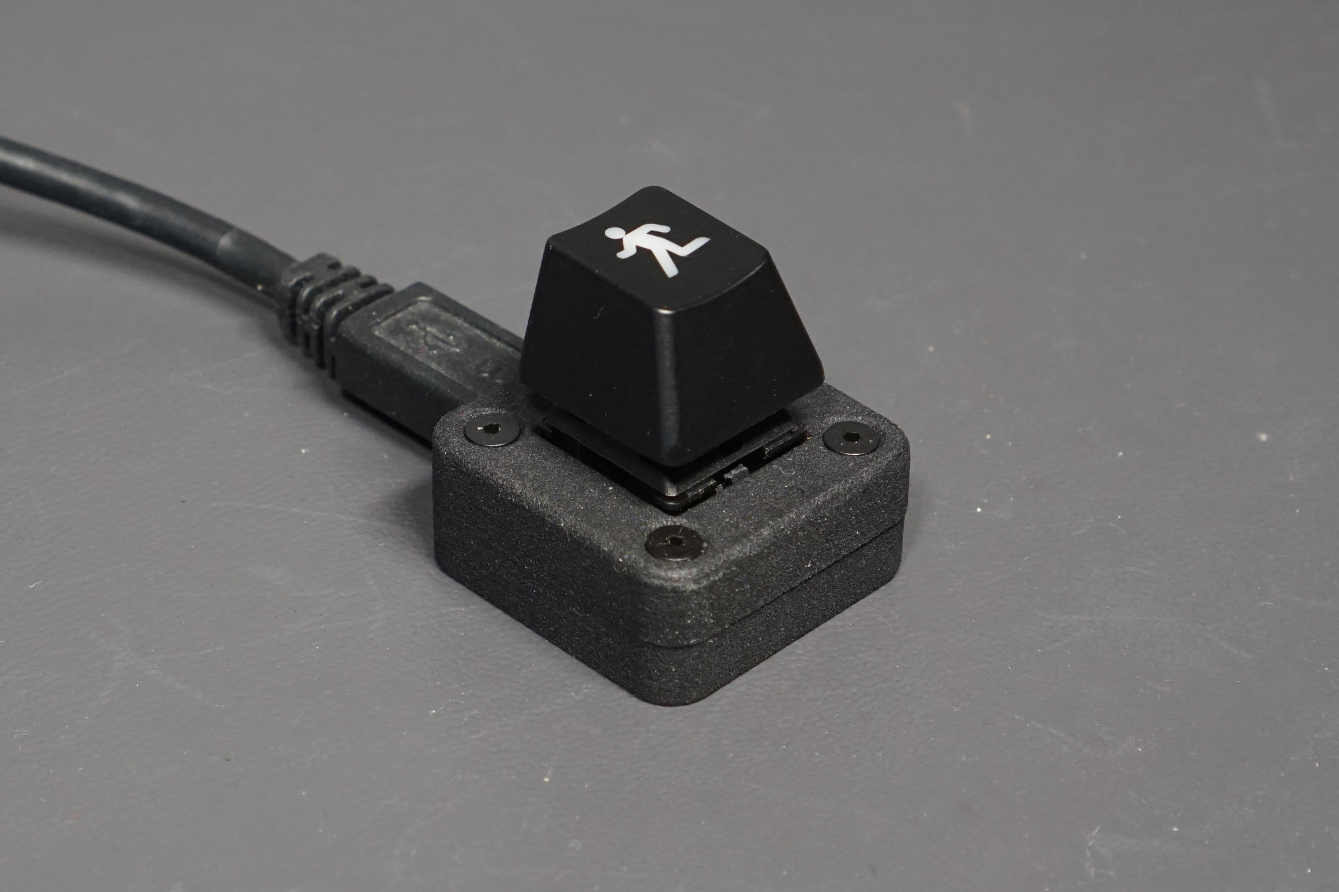
THE ENDGAME

Slide 50
QUESTIONS?
SANOFI

Slide 51
CREDITS
Cover pic:
/u/Kyek (github.com/duckyb)
Taobao Supreme pic:
/u/dantambok
Moonlander pic:
hardwarecanucks.com
Corne pic:
/u/molwams (imgur.com/gallery/0XtplrD)
Skeletyl pic:
@urza_cc
Miryoku keymap:
Manna Harbour (github.com/manna-harbour)

